Slide 1
Medical Project – Seminar IN-STK5000 – Adaptive Methods for Data-Based Decision Making Fall 2018
Presented by:
Oda Johanne Kristensen & Lars Henry Berge Olsen
Notes:
Lars

Slide 2
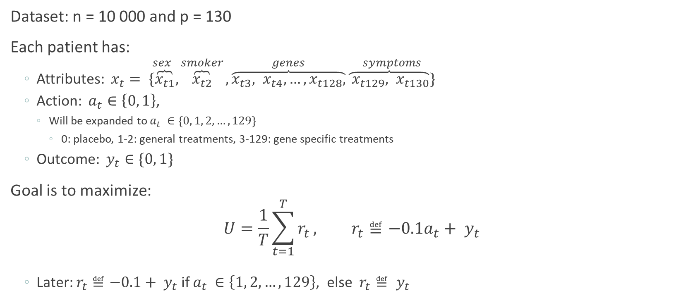
Overview of the Medical Project
Dataset: n = 10 000 and p = 130
Each patient has:
Attributes: $x_{t}= \overset{sex}{\{\overbrace{x_{t1}}},\overset{smoker}{\overbrace{x_{t2}}},\overset{genes}{\overbrace{x_{t3}, x_{t4}, …,x_{t128},}}\overset{symptoms}{\overbrace{ x_{t129}, x_{t130}}\}}$
Action: $a_{t}∈\left\{0, 1\right\}$,
Will be expanded to $a_{t} ∈\left\{0, 1, 2,…,129\right\}$
0: placebo, 1-2: general treatments, 3-129: gene specific treatments
Outcome: $y_{t}∈\{0, 1\}$
Goal is to maximize:
$$U=\frac{1}{T}\sum_{t=1}^{T}{r_{t}}, r_{t}≝−0.1a_{t}+ y_{t}$$
Later: $r_{t}≝−0.1+ y_{t}$ if $a_{t} ∈\left\{1, 2,…,129\right\}$, else $r_{t}≝ y_{t}$
Notes:
Lars
A little overview first. We are given a dataset of 10 000 patients. For each patient we can see their attribute x, the historical action and the outcome.
Throughout this project we want to find a policy that maximizes the utility, given by the mean of the rewards. The reward function implies that there is a small penalty associated with the use of a treatment. Thus, the policy should be somewhat certain that a treatment will yield a positive result before recommending it. If we omit this term, all our models recommend the treatment 100% of the time, since the estimated reward of the treatment is higher than the placebo.
Later, when we get new actions we let the penalty be the same for all treatments.

Slide 3
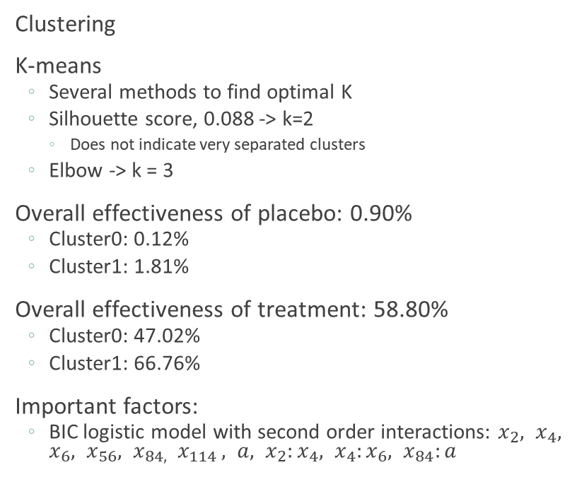
Part 1 Part 2
Clustering
K-means
Several methods to find optimal K
Silhouette score, 0.088 -> k=2
Does not indicate very separated clusters
Elbow -> k = 3
Overall effectiveness of placebo: 0.90%
Cluster0: 0.12%
Cluster1: 1.81%
Overall effectiveness of treatment: 58.80%
Cluster0: 47.02%
Cluster1: 66.76%
Important factors:
BIC logistic model with second order interactions: $x_{2}, x_{4}, x_{6}, x_{56}, x_{84, } x_{114 }, a, x_{2}:x_{4}, x_{4}:x_{6}, x_{84}:a$
Improved policies
Historical utility: 0.119
Bootstrap 95% CI: [0.113, 0.126]
Improved policies: logistic model, neural network
Increase robustness of model
Bootstrap probability consensus for logistic model
Tuning hidden layers configurations with CV for neural network
Estimated utility:
logistic: 0.427
NN(5,2): 0.465
True utility:
logistic:
NN(5,2): 0.442
Notes:
Oda

Slide 4
Part 3
 | Historical | Logistic 1 | Logistic 2 * | NN(2,2,3) | NN(5,2) | Placebo | Treatment 1 | Random | Optimal
Average utility | 0.1085 | 0.464 | 0.467 | 0.464 | 0.462 | 0.012 | 0.430 | 0.220 | 0.481
Empirical 95% CI | [0.084, 0.129] | [0.432, 0.503] | [0.423, 0.501] | [0.432, 0.514] | [0.415, 0.505] | [0.004, 0.023] | [0.395, 0.475] | [0.187, 0.256] | [0.448, 0.515]
Percentage of patients recommended treatment | 23% | 67.2% | 68.0% | 58.0% | 53.3% | 0% | 100% | 54% | 53.4%
Empirical 95% CI | [20.1%, 26.4%] | [63.6%, 70.8%] | [64.3%, 71.2%] | [53.8%, 62.4%] | [48.5%, 58.1%] | - | - | - | [49.8%, 57.2%]
Table 1: The empirical 95% CI and median estimates for the static policies. 100 simulations with 500 patients.
 | Logistic 2* | NN(5,2) | Optimal | Logistic 2* | NN(5,2) | Optimal
Possible treatment | 0, 1 | 0, 1 | 0, 1 | 0, 1, 2 | 0, 1, 2 | 0, 1, 2
Average utility | 0.468 | 0.469 | 0.486 | 0.500 | 0.622 | 0.666
Empirical 95% CI | [0.3738, 0.556] | [0.370, 0.550] | [0.391, 0.572] | [0.500, 0.500] | [0.521, 0.693] | [0.589, 0.738]
Percentage of patients recommended treatment | 67.0% | 54.0% | 54.0% | 100% | 98.0% | 74.0%
Empirical 95% CI | [59.0%, 76.1%] | [44.0%, 62.5%] | [43.5%, 63.5%] | [100%, 100%] | [95.0%, 100%] | [65.4%, 82.0%]
Table 2: The empirical 95% CI and median estimates for the adaptive policies. Note first row. 100 simulations and 100 patients.
Notes:
Here we test our policies on new patients.
In the first table we have created empirical estimates by letting each policy treat 500 patients 100 times.
We see that the historical recommender and the improved recommenders perform at the same level as in the previous part. The confidence intervals of our models overlap a lot, they are equally good. Note that the neural network recommends the drug less often, i.e. it’s less optimistic and more precise.
The clustered versions yield approximately the same results, and hence we have omitted them from the table.
As benchmarks we have created policies that always recommend placebo, the drug and does a random choice. We see that our models are better than these. Since we know how the outcomes are generated we have also made an optimal recommender that yields the optimal results. Note that our models are not far from optimal.
In the second table on the left we have adaptive models that learn from the outcomes of their recommendations. There are not much improvements here. Maybe because the new information drowns in the old data or there is some underlying noise that cannot be reduced. Note that each model now only treats 100 persons, due to the computational time, hence the wider intervals.
On the right side, the models are still adaptive, but they can also recommend the 2nd treatment. The neural network gives close to optimal results, even though it is optimistic and recommend the treatments too often. The logistic model fails completely. It always recommends the 2nd treatment, due to the coefficient corresponding to the action variable being positive and that it is too optimistic. Same problem if we introduce more treatments.
Lars og Oda
Lars: testbench, tabell over hist og improved
Here we test our policies on new patients. The goal is to maximize the utility function I talked about earlier.
We have created empirical estimates by running 100 simulations with 500 patients for each policy, in the first table.
We see that the historical recommender and the improved recommenders perform at the same level as on the historical data in the previous section. The confidence intervals of our models overlap a lot. Which implies that the models perform at the same level. Note that the NN recommends the drug less often, i.e. better at finding when it should recommend it.
The clustered versions yield approximately the same results, and hence we have omitted them.
As benchmarks we have created policies that always recommend placebo, the drug and does a random choice. We see that our models are better than these. Since we know how the outcomes are generated we have also made an optimal recommender that yields the optimal results. Note that our models are not far from optimal.
In the second table on the left we have dynamic models which observe the outcomes of the actions they recommends, and learn from it. There are not much improvements here. Note that we here have reduced number of patients down to 100 due to computational times, hence the wider intervals.
On the right side, the models are still adaptive but they can also recommend the 2nd treatments. It works very good for the NN, close to the optimal, even though it recommends the treatments way to often, so a bit optimistic. The logistic is way to optimistic and recommend the 2nd drug to often. Never recommends 1, since the beta-coefficient is positive. Would have had the same problem with 129 drugs.
Oda: Adaptive + new treatment
Lars: If we treat a patient with both the experiments, and look at when they work we get this venn-diagram. As we can see there is a overlap between treatment 1 and 2. And neither of them work on 26 patients. What we have done
Oda: Policy 0,1,2
We see that the historical recommender gives a low CI, and median of 0.11. Note that the results we got in part 2 is covered by this CI.
We now look at the improved recommenders. We see that there is basically no difference between a single logistic or a probability consensus.
The Neural Network yields approximately the same utility, but the manage to do that with less use of the drug. That means that the NN is better at to discover when it is necessary to use drug, while the logistic model is to optimistic of the effect of the treatment.
We have 2 different NN, the first one obtained by CV on the historical data. The other one is a suboptimal NN, but recommends less treatments.
As benchmarks we have also checked what happens if we always recommend placebo, treatment 1 or random. We see that our models get slightly better scores than when we always recommend the treatment.
Clustered versions give the same results.
Cheat is a recommender that exploits our knowledge about the data generator and always chooses the correct recommendation. We see that there is not much more we can enhance our models. Of course in the real world we would not have known that.
We now look at the adaptive recommenders.
That means that we let the models observe the outcome of each patients, and then refit our models. This take a long time. So we have decreased number of patients to 100 per simulation. Hence, we get wider CI. So it is now better to look at the medians. As we see, they are a little bit better. But nothing to cheer about. Might be because the new results drown in the fitting. Should maybe have done something else. Still close to cheats optimal value.
Now we are given new treatments. A general one and 126 gene specif. We have interpreted it as action 3 is specific to gene 1, action 4 is specific to gene 2 and so one. We see the new general treatments overlaps the old one. Here we have treated the same patients (100 000) with both treatments and looked at the outcomes of each treatment. In the real world this is possible if the treatments are f.ex. Sunscreens. Apply the to each arm and look at the results. Not possible in other scenarios.
We see here that treatment 1 or 2 doesn’t work in 26% of the cases, and they have some overlap.
If we let our models have the choice between action 0, 1 and 2, we get some bad results and some good. It doesn’t work for logistic. We get that the coefficient infront of the action variable is positive, hence the model always chose the biggest action. We might have
If we do the same for the gene specific treatment we get discouraging results. Of these 100 000 patients we observed no instances where the patient displayed measurable effects based on a gene specific and where the general treatments didn’t work. There are cases where the gene specific treatments are the only treatments that work, but these are so rare, that we are better of recommending the general treatments.
One remark. We have fixed a seed such that each model recommend an action for the same patients. We now this is not realistic in the real world. However, the results we got when we looked at different patients varied a lot. We observed that a recommender that was the best in one run would be the worst in the next one. We could have increased the number of patients, but the code had a long running time.
First we test the historical recommender. We see that we obtain a 95% CI from 5.1 to 17.5. Better [8,96, 12,79] with n_test 1000. That is quite a wide interval. Maybe due to the low number of n-test. Either way. We see that the historical is situated in the middle.
All the CI on the left side is made by running the code 100 times with 500 pasients each time
historical
[0.0839, 0.1293], median 0.1085
Percentage of times given medicin: [0.201, 0.264], median = 0.23
Log regular
[0.432, 0.503], median = 0.464
Percentage of times given medicin: [0.636, 0.708], median = 0.672
Log boot
[0.423, 0.501], median = 0.467
Percentage of times given medicin: [0.643, 0.712] median = 0.680
Neural Network!
[0.415, 0.505], median = 0.462
Percentage of times given medicin: [0.485, 0.581] median = 0.533
Neural Network (2,2,3)
[0.432, 0.514], median = 0.464, medicine: [0.538, 0.624], median = 0.58
anty1, anty2, antjusty1, antjusty2, antboth, antnone
53553 54690 19312 20449 34241 25998
Logistic regular 100 iter with n_test = 500: [0.4264, 0.5086]
Adaptive:
Cheat only placebo and drug 1:
Ntest=100: [0.391, 0.572], median = 0.486, medicine: [0.435, 0.635], median = 0.540
Ntest=500: [0.448, 0.515], median = 0.481, medicine: [0.498, 0.572], median = 0.534
NN [0.3698, 0.5500], median = 0.467
[0.440, 0.625], median = 0.54
Log boot, [0.3738, 0.556], median = 0.464 medicine: [59.0%, 76,1%], median = 67.0%
New treatments:
NN2
[0.521, 0.693], median = 0.622
[0.95, 1.0], median = 0.98
Cheat:
N_tests = 100: [0.589, 0.738], median = 0.666 medicine [0.654, 0.820], median = 0.740
N_tests = 500: [0.637, 0.696], median = 0.666 medicine [0.708, 0.773], median = 0.744

Slide 5
Analysis of Treatments
Treatment 1
Treatment 2
19.3%
34.3%
20.4%
26.0%
Figure 1: Venn diagram of the success rates of treatment 1 and 2. Generated from 100 000 patients.
Treatment | Utility | Success: | %gen 0 | %gen 1 | Fail: | %gene 0 | %gene 1 | Success rate gene0 gene1
2 | 4443 | 5443 |  |  | 4557 |  |  | 0.554
1 | 4341 | 5341 |  |  | 4659 |  |  | 0.534
0 | 140 | 140 |  |  | 9860 |  |  | 0.014
127 | -94 | 906 | 0.091 | 0.909 | 9094 | 0.448 | 0.552 | 0.020 0.141
86 | -397 | 603 | 0.221 | 0.799 | 9397 | 0.531 | 0.469 | 0.026 0.096
Table 3: The success rates of the five best treatments. For the gene specific treatment we have also displayed the percentage of times the corresponding gene was 0 and 1.
Notes:
Lars:
We did some analysis of the treatments. If we treat a patient with both the general treatments, think of applying two sunscreens to each arm, and look at their effect we get this Venn diagram. There some overlap and they don’t treat some patients. When we did the same with a general treatment and a gene specific treatment, we never obtained an instance for which the gene specific treatment worked but not the general. It can happen, but in rare instances.
In table we table we see the 5 most effective treatments. We want to make a point here about the gene specific treatments, take number 127. If the treatment was a success, we can see that gene 125 was likely a 1. This doesn’t mean that given a patient with gene 125 being 1, that we should recommend treatment 127, as seen here. Since the success rate is low compared to the general treatments and the fact that our policies recommend based on the estimated utility, they are not going to recommend treatment 127. Well they do sometimes, but that’s because we do not have enough information about them for out models to do a good job.

Slide 6
Further investigation
Look at different costs for different treatments
Extra weight to the new observations
Gene targeting on several genes

Slide 7
Part 3
Test Bench
Goal: max utility, not treated people (always give drug)
Results highly depended on the patients
Adaptive recommender: (100 patients -> wider intervals, B=100)
Logistic probability consensus: [0.3738, 0.556], 0.468
Recomended medicine [59.0%, 76.1%], 67.0%
Neural Network (5,2): [0.370, 0.550], 0.469
Recomended medicine [44.0%, 62.5%] , 54.0%
Cheat: [0.391, 0.572], 0.486.
Recomended medicine [43.5%, 63.5%], 54.0%
Historical Recommender: (500 patients, B=100)
95% empirical CI: [0.084, 0.129], median: 0.1085
Recomended medicine [20.1%, 26.4%], 23%
Improved recommenders: (500 patients, B=100)
Logistic: [0.432, 0.503], 0.464
Recomended medicine [63.6%, 70.8%], 67.2%
Logistic probability consensus: [0.423, 0.501], 0.467
Recomended medicine [64.3%, 71.2%], 68.0%
Neural Network (2,2,3): [0.432, 0.514], 0.464
Recomended medicine [53.8%, 62.4%], 58.0%
Neural Network (5,2): [0.415, 0.505], 0.462
Recomended medicine [48.5%, 58.1%], 53.3%
Clustered versions gave the same results
Placebo: [0.004, 0.023], 0.012
Treatment 1: [0.395, 0.475], 0.430
Random: [0.187, 0.256], 0.220
Cheat: [0.448, 0.515], 0.481.
Recomended medicine [49.8%, 57.2%], 53.4%
New Treatments:
A general treatment and gene specific treatments
The general overlaps with the previous general,
Apply treatments to same person, realistic and unrealistic.
Placebo, treatment 1 and treatment 2: (100 patients, B=100)
Logistic probability consensus:
Bad. The action coeffiecient is postive, so chose treatment 2 always.
Neural Network (5,2): [0.521, 0.693], 0.622
Recomended medicine [95.0%, 100%] , 98.0%
Cheat: [0.589, 0.738], 0.666
Recomended medicine [65.4%, 82.0%], 74.0%
Treatment 1
Treatment 2
19.3%
34.3%
20.4%
26.0%
Notes:
Lars og Oda
Lars: testbench, tabell over hist og improved
Here we test our policies on new patients. The goal is to maximize the utility function I talked about earlier.
One should note that the results of the policies depend highly on the group of patients, that is, the difference in utility for two groups can be vast. Thus, multiple simulations are crucial. In each simulation we let our polices treat 500 patients, and we run 100 simulations. Then we compute the empirical 95% confidence interval and the empirical median. We can see the results in this table.
We see that the historical recommender perform at the same levels as on the historical data. Our models perform much better, at the same level as in the previous part, and the confidence intervals overlaps a lot. This means that having a probability consensus for the logistic model doesn’t matter, just takes longer computational time. (As expected since the result of ensemble learners are better if the individual learners are weak.)
The neural networks yield the same intervals, but note that they recommend the treatment less often than the logistic model. We have two different NN, one optimal obtained by cross validation and one suboptimal with less prescriptions.
The clustered versions yields approximately the same results, and hence we have omitted them.
As benchmarks we have created policies that always recommend placebo, the drug and does a random choice. We see that our models are better than always recommending the treatment. Since we know how the outcomes are generated in the generator file we have made a cheat recommender that yields the optimal results. Note that our models are not far from optimal.
Oda: Adaptive + new treatment
Lars: If we treat a patient with both the experiments, and look at when they work we get this venn-diagram. As we can see there is a overlap between treatment 1 and 2. And neither of them work on 26 patients. What we have done
Oda: Policy 0,1,2
We see that the historical recommender gives a low CI, and median of 0.11. Note that the results we got in part 2 is covered by this CI.
We now look at the improved recommenders. We see that there is basically no difference between a single logistic or a probability consensus.
The Neural Network yields approximately the same utility, but the manage to do that with less use of the drug. That means that the NN is better at to discover when it is necessary to use drug, while the logistic model is to optimistic of the effect of the treatment.
We have 2 different NN, the first one obtained by CV on the historical data. The other one is a suboptimal NN, but recommends less treatments.
As benchmarks we have also checked what happens if we always recommend placebo, treatment 1 or random. We see that our models get slightly better scores than when we always recommend the treatment.
Clustered versions give the same results.
Cheat is a recommender that exploits our knowledge about the data generator and always chooses the correct recommendation. We see that there is not much more we can enhance our models. Of course in the real world we would not have known that.
We now look at the adaptive recommenders.
That means that we let the models observe the outcome of each patients, and then refit our models. This take a long time. So we have decreased number of patients to 100 per simulation. Hence, we get wider CI. So it is now better to look at the medians. As we see, they are a little bit better. But nothing to cheer about. Might be because the new results drown in the fitting. Should maybe have done something else. Still close to cheats optimal value.
Now we are given new treatments. A general one and 126 gene specif. We have interpreted it as action 3 is specific to gene 1, action 4 is specific to gene 2 and so one. We see the new general treatments overlaps the old one. Here we have treated the same patients (100 000) with both treatments and looked at the outcomes of each treatment. In the real world this is possible if the treatments are f.ex. Sunscreens. Apply the to each arm and look at the results. Not possible in other scenarios.
We see here that treatment 1 or 2 doesn’t work in 26% of the cases, and they have some overlap.
If we let our models have the choice between action 0, 1 and 2, we get some bad results and some good. It doesn’t work for logistic. We get that the coefficient infront of the action variable is positive, hence the model always chose the biggest action. We might have
If we do the same for the gene specific treatment we get discouraging results. Of these 100 000 patients we observed no instances where the patient displayed measurable effects based on a gene specific and where the general treatments didn’t work. There are cases where the gene specific treatments are the only treatments that work, but these are so rare, that we are better of recommending the general treatments.
One remark. We have fixed a seed such that each model recommend an action for the same patients. We now this is not realistic in the real world. However, the results we got when we looked at different patients varied a lot. We observed that a recommender that was the best in one run would be the worst in the next one. We could have increased the number of patients, but the code had a long running time.
First we test the historical recommender. We see that we obtain a 95% CI from 5.1 to 17.5. Better [8,96, 12,79] with n_test 1000. That is quite a wide interval. Maybe due to the low number of n-test. Either way. We see that the historical is situated in the middle.
All the CI on the left side is made by running the code 100 times with 500 pasients each time
historical
[0.0839, 0.1293], median 0.1085
Percentage of times given medicin: [0.201, 0.264], median = 0.23
Log regular
[0.432, 0.503], median = 0.464
Percentage of times given medicin: [0.636, 0.708], median = 0.672
Log boot
[0.423, 0.501], median = 0.467
Percentage of times given medicin: [0.643, 0.712] median = 0.680
Neural Network!
[0.415, 0.505], median = 0.462
Percentage of times given medicin: [0.485, 0.581] median = 0.533
Neural Network (2,2,3)
[0.432, 0.514], median = 0.464, medicine: [0.538, 0.624], median = 0.58
anty1, anty2, antjusty1, antjusty2, antboth, antnone
53553 54690 19312 20449 34241 25998
Logistic regular 100 iter with n_test = 500: [0.4264, 0.5086]
Adaptive:
Cheat only placebo and drug 1:
Ntest=100: [0.391, 0.572], median = 0.486, medicine: [0.435, 0.635], median = 0.540
Ntest=500: [0.448, 0.515], median = 0.481, medicine: [0.498, 0.572], median = 0.534
NN [0.3698, 0.5500], median = 0.467
[0.440, 0.625], median = 0.54
Log boot, [0.3738, 0.556], median = 0.464 medicine: [59.0%, 76,1%], median = 67.0%
New treatments:
NN2
[0.521, 0.693], median = 0.622
[0.95, 1.0], median = 0.98
Cheat:
N_tests = 100: [0.589, 0.738], median = 0.666 medicine [0.654, 0.820], median = 0.740
N_tests = 500: [0.637, 0.696], median = 0.666 medicine [0.708, 0.773], median = 0.744

Slide 8
Part 3
Test Bench
Goal: max utility, not treated people (always give drug)
Results highly depended on the patients
Adaptive recommender: (100 patients -> wider intervals, B=100)
Logistic probability consensus: [0.3738, 0.556], 0.468
Recomended medicine [59.0%, 76.1%], 67.0%
Neural Network (5,2): [0.370, 0.550], 0.469
Recomended medicine [44.0%, 62.5%] , 54.0%
Cheat: [0.391, 0.572], 0.486.
Recomended medicine [43.5%, 63.5%], 54.0%
Historical Recommender: (500 patients, B=100)
95% empirical CI: [0.084, 0.129], median: 0.1085
Recomended medicine [20.1%, 26.4%], 23%
Improved recommenders: (500 patients, B=100)
Logistic: [0.432, 0.503], 0.464
Recomended medicine [63.6%, 70.8%], 67.2%
Logistic probability consensus: [0.423, 0.501], 0.467
Recomended medicine [64.3%, 71.2%], 68.0%
Neural Network (2,2,3): [0.432, 0.514], 0.464
Recomended medicine [53.8%, 62.4%], 58.0%
Neural Network (5,2): [0.415, 0.505], 0.462
Recomended medicine [48.5%, 58.1%], 53.3%
Clustered versions gave the same results
Placebo: [0.004, 0.023], 0.012
Treatment 1: [0.395, 0.475], 0.430
Random: [0.187, 0.256], 0.220
Cheat: [0.448, 0.515], 0.481.
Recomended medicine [49.8%, 57.2%], 53.4%
New Treatments:
A general treatment and gene specific treatments
The general overlaps with the previous general,
Apply treatments to same person, realistic and unrealistic.
Placebo, treatment 1 and treatment 2: (100 patients, B=100)
Logistic probability consensus:
Bad. The action coeffiecient is postive, so chose treatment 2 always.
Neural Network (5,2): [0.521, 0.693], 0.622
Recomended medicine [95.0%, 100%] , 98.0%
Cheat: [0.589, 0.738], 0.666
Recomended medicine [65.4%, 82.0%], 74.0%
(same result for 129 treat)
Treatment 1
Treatment 2
19.3%
34.3%
20.4%
26.0%
Notes:
In this part we are going to test our models on new patients.
Some remarks first, we want to maximize the reward function we displayed earlier, and not the expected number of people who display measurable effects as the description says we should. If we had done this the models always recommend the drug, since there is no penalty of giving the drug and it is more likely to yield measurable effects.
The results of the models also depend highly on the data generated in each run. If we want to compare the different policies based on single simulation we should test the policies on the same group of patients. We have not done this. We have run the simulations 100 times and computed the empirical 95% CI and median. In each simulation we treat 500 patients.
We see that the historical recommender gives a low CI, and median of 0.11. Note that the results we got in part 2 is covered by this CI.
We now look at the improved recommenders. We see that there is basically no difference between a single logistic or a probability consensus.
The Neural Network yields approximately the same utility, but the manage to do that with less use of the drug. That means that the NN is better at to discover when it is necessary to use drug, while the logistic model is to optimistic of the effect of the treatment.
We have 2 different NN, the first one obtained by CV on the historical data. The other one is a suboptimal NN, but recommends less treatments.
As benchmarks we have also checked what happens if we always recommend placebo, treatment 1 or random. We see that our models get slightly better scores than when we always recommend the treatment.
Clustered versions give the same results.
Cheat is a recommender that exploits our knowledge about the data generator and always chooses the correct recommendation. We see that there is not much more we can enhance our models. Of course in the real world we would not have known that.
We now look at the adaptive recommenders.
That means that we let the models observe the outcome of each patients, and then refit our models. This take a long time. So we have decreased number of patients to 100 per simulation. Hence, we get wider CI. So it is now better to look at the medians. As we see, they are a little bit better. But nothing to cheer about. Might be because the new results drown in the fitting. Should maybe have done something else. Still close to cheats optimal value.
Now we are given new treatments. A general one and 126 gene specif. We have interpreted it as action 3 is specific to gene 1, action 4 is specific to gene 2 and so one. We see the new general treatments overlaps the old one. Here we have treated the same patients (100 000) with both treatments and looked at the outcomes of each treatment. In the real world this is possible if the treatments are f.ex. Sunscreens. Apply the to each arm and look at the results. Not possible in other scenarios.
We see here that treatment 1 or 2 doesn’t work in 26% of the cases, and they have some overlap.
If we let our models have the choice between action 0, 1 and 2, we get some bad results and some good. It doesn’t work for logistic. We get that the coefficient infront of the action variable is positive, hence the model always chose the biggest action. We might have
If we do the same for the gene specific treatment we get discouraging results. Of these 100 000 patients we observed no instances where the patient displayed measurable effects based on a gene specific and where the general treatments didn’t work. There are cases where the gene specific treatments are the only treatments that work, but these are so rare, that we are better of recommending the general treatments.
One remark. We have fixed a seed such that each model recommend an action for the same patients. We now this is not realistic in the real world. However, the results we got when we looked at different patients varied a lot. We observed that a recommender that was the best in one run would be the worst in the next one. We could have increased the number of patients, but the code had a long running time.
First we test the historical recommender. We see that we obtain a 95% CI from 5.1 to 17.5. Better [8,96, 12,79] with n_test 1000. That is quite a wide interval. Maybe due to the low number of n-test. Either way. We see that the historical is situated in the middle.
All the CI on the left side is made by running the code 100 times with 500 pasients each time
historical
[0.0839, 0.1293], median 0.1085
Percentage of times given medicin: [0.201, 0.264], median = 0.23
Log regular
[0.432, 0.503], median = 0.464
Percentage of times given medicin: [0.636, 0.708], median = 0.672
Log boot
[0.423, 0.501], median = 0.467
Percentage of times given medicin: [0.643, 0.712] median = 0.680
Neural Network!
[0.415, 0.505], median = 0.462
Percentage of times given medicin: [0.485, 0.581] median = 0.533
Neural Network (2,2,3)
[0.432, 0.514], median = 0.464, medicine: [0.538, 0.624], median = 0.58
anty1, anty2, antjusty1, antjusty2, antboth, antnone
53553 54690 19312 20449 34241 25998
Logistic regular 100 iter with n_test = 500: [0.4264, 0.5086]
Adaptive:
Cheat only placebo and drug 1:
Ntest=100: [0.391, 0.572], median = 0.486, medicine: [0.435, 0.635], median = 0.540
Ntest=500: [0.448, 0.515], median = 0.481, medicine: [0.498, 0.572], median = 0.534
NN [0.3698, 0.5500], median = 0.467
[0.440, 0.625], median = 0.54
Log boot, [0.3738, 0.556], median = 0.464 medicine: [59.0%, 76,1%], median = 67.0%
New treatments:
NN2
[0.521, 0.693], median = 0.622
[0.95, 1.0], median = 0.98
Cheat:
N_tests = 100: [0.589, 0.738], median = 0.666 medicine [0.654, 0.820], median = 0.740
N_tests = 500: [0.637, 0.696], median = 0.666 medicine [0.708, 0.773], median = 0.744

